Slide 1


Coffee Chain
01

Slide 2

Team Members
07
V
Amwaj Alshamrani
Hussain Alibrahim
Khulud Alawaji
Latifah Alhwiseen
Mariam Alhawiti

Slide 3



AGENDA
02
Data Collection
Data Processing
Data Visualization

Slide 4

Data Collection
03
The Dataset have 21 columns ​
Coffee chain located in US​
Over 4200 rows​
Data between 2012-2013​
Author Tahir Hussain from Kaggle

Slide 5

Data Processing
"
04
Extract year​
​
Extract month
Remove null rows
Split the year into quarters
Replace " Territory " with " Region"
Replace "Territory size" with "market size"
Editing data type for the sales, profit, and COGS

Slide 6
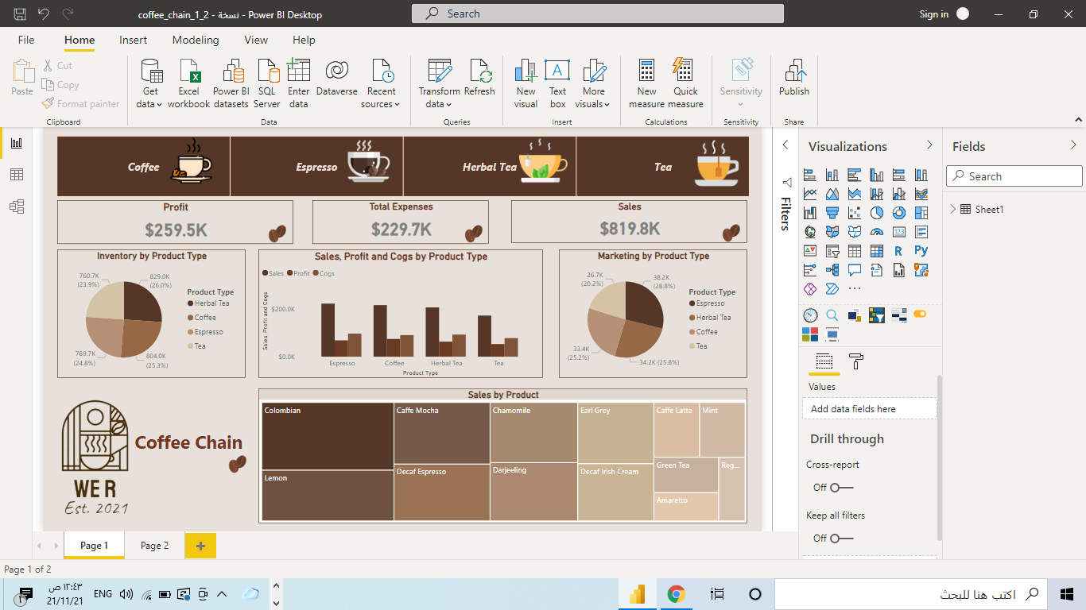

Visualization
05
Data

Slide 7
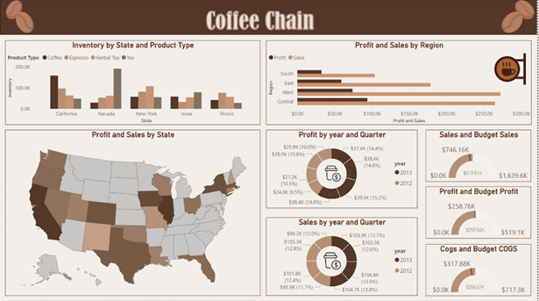
Visualization
06
Data

Slide 8
THINK YOU
07
V
DO YOU HAVE ANY QUESTIONS?

